Slide 1
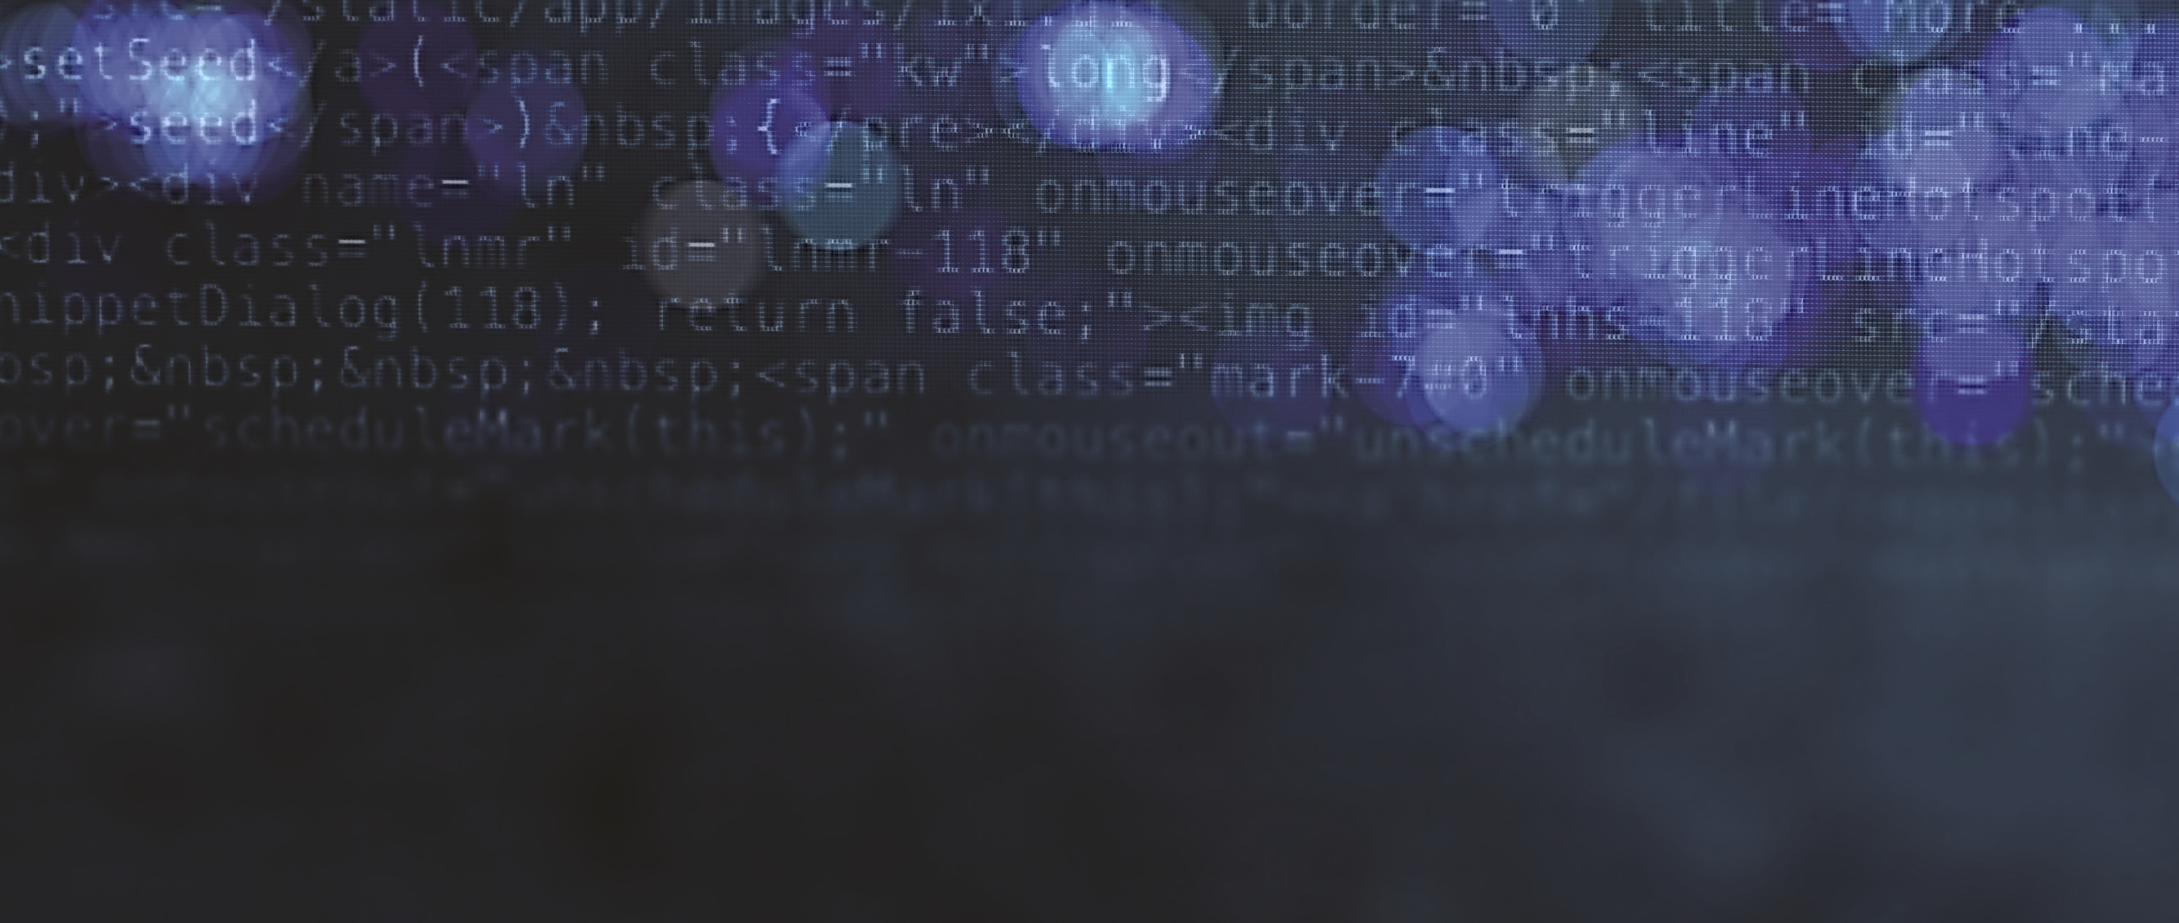

Cybersecurity for Journalists
(and Everyone!)
Thursday, February 23, 2017
Media School
Indiana University

Slide 2

Panelists
Nate Cardozo
  Electronic Frontier Foundation
Anthony L. Fargo
  IU Center for International Media Law and Policy
Marisa Kwiatkowski
  Indianapolis Star
Susan Sons
  IU Center for Applied Cybersecurity Research

Slide 3
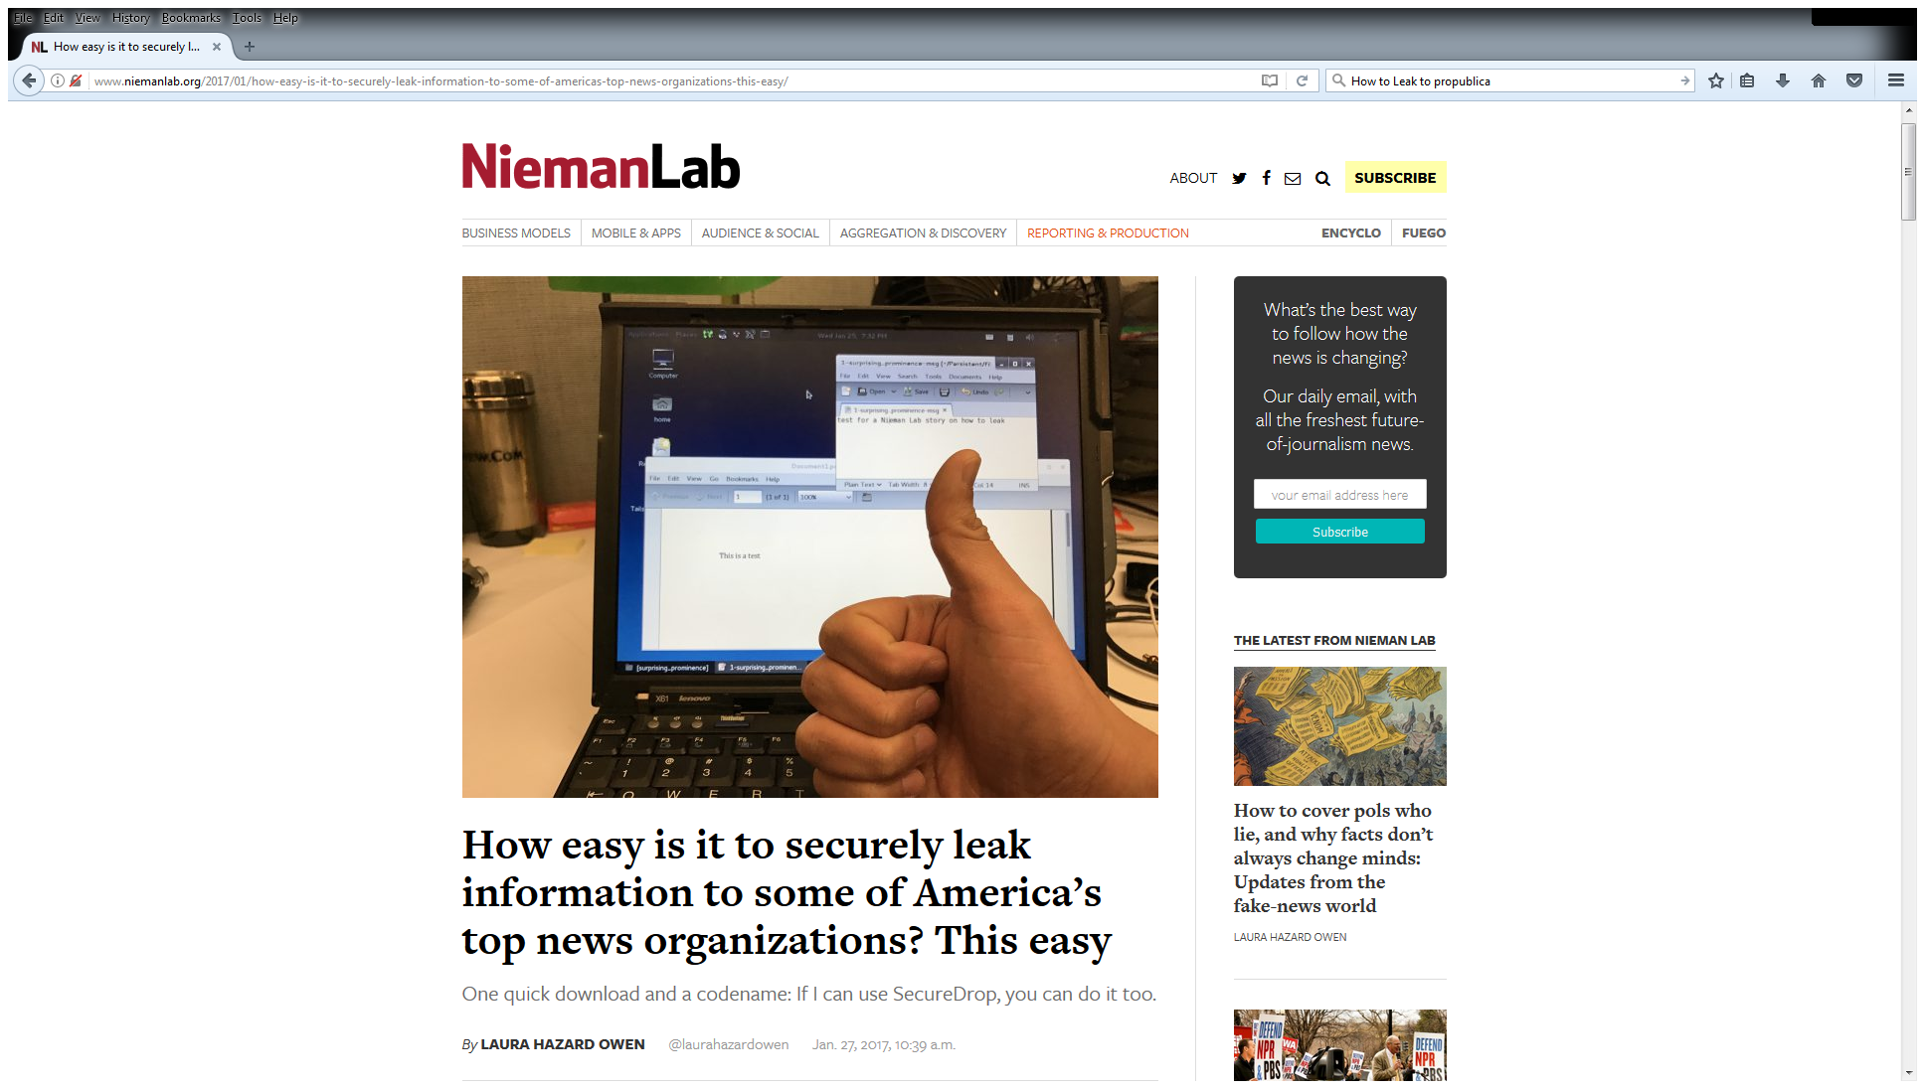

Slide 4
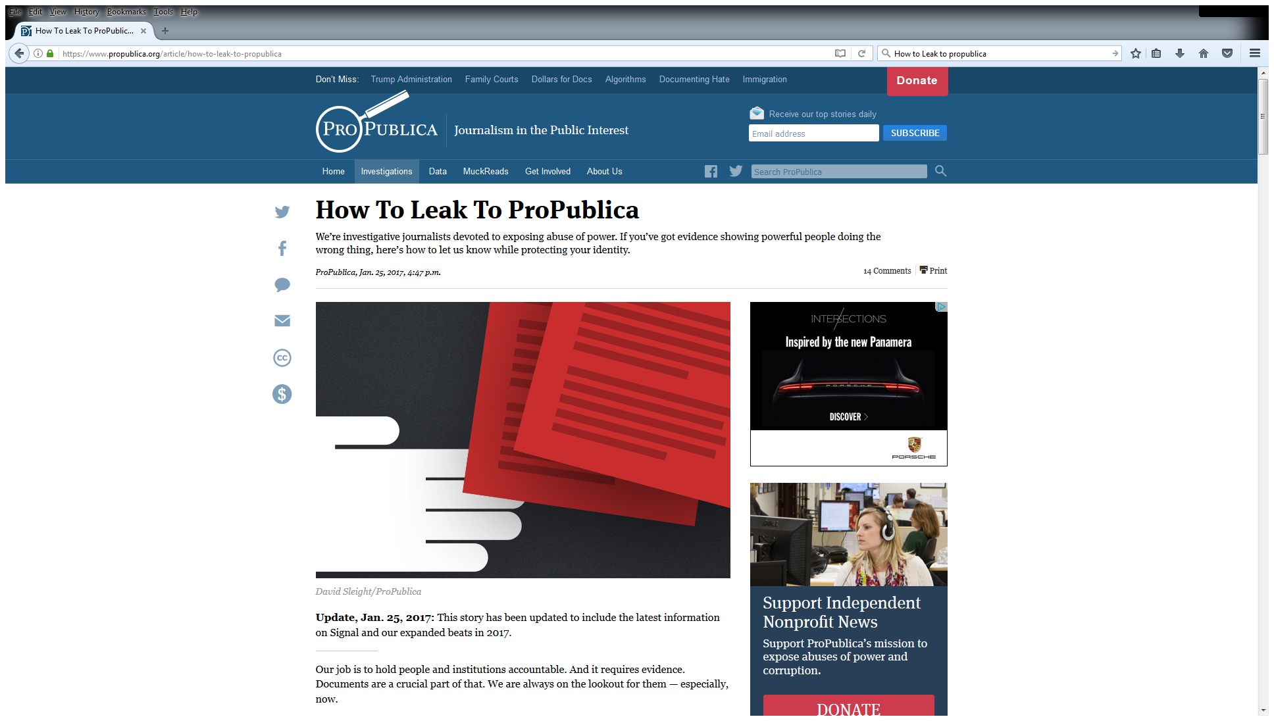

Slide 5
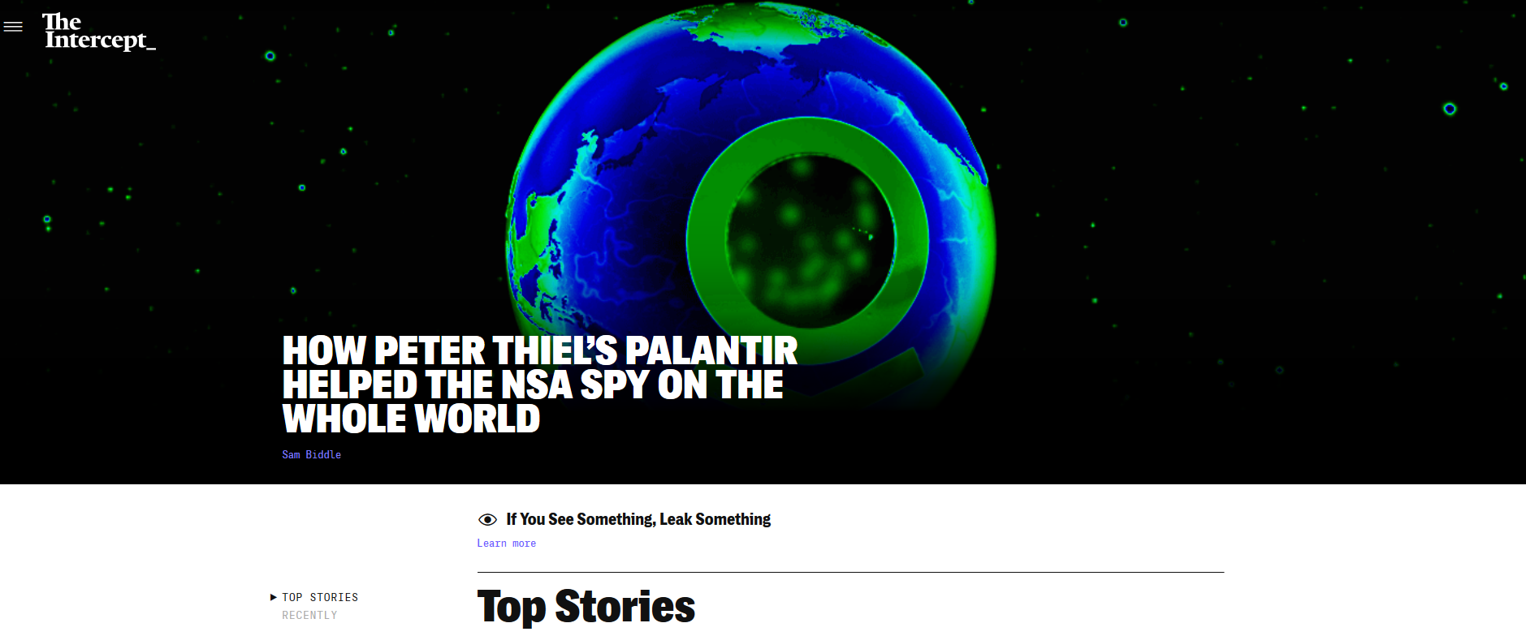
“If You See Something, Leak Something”

Slide 6
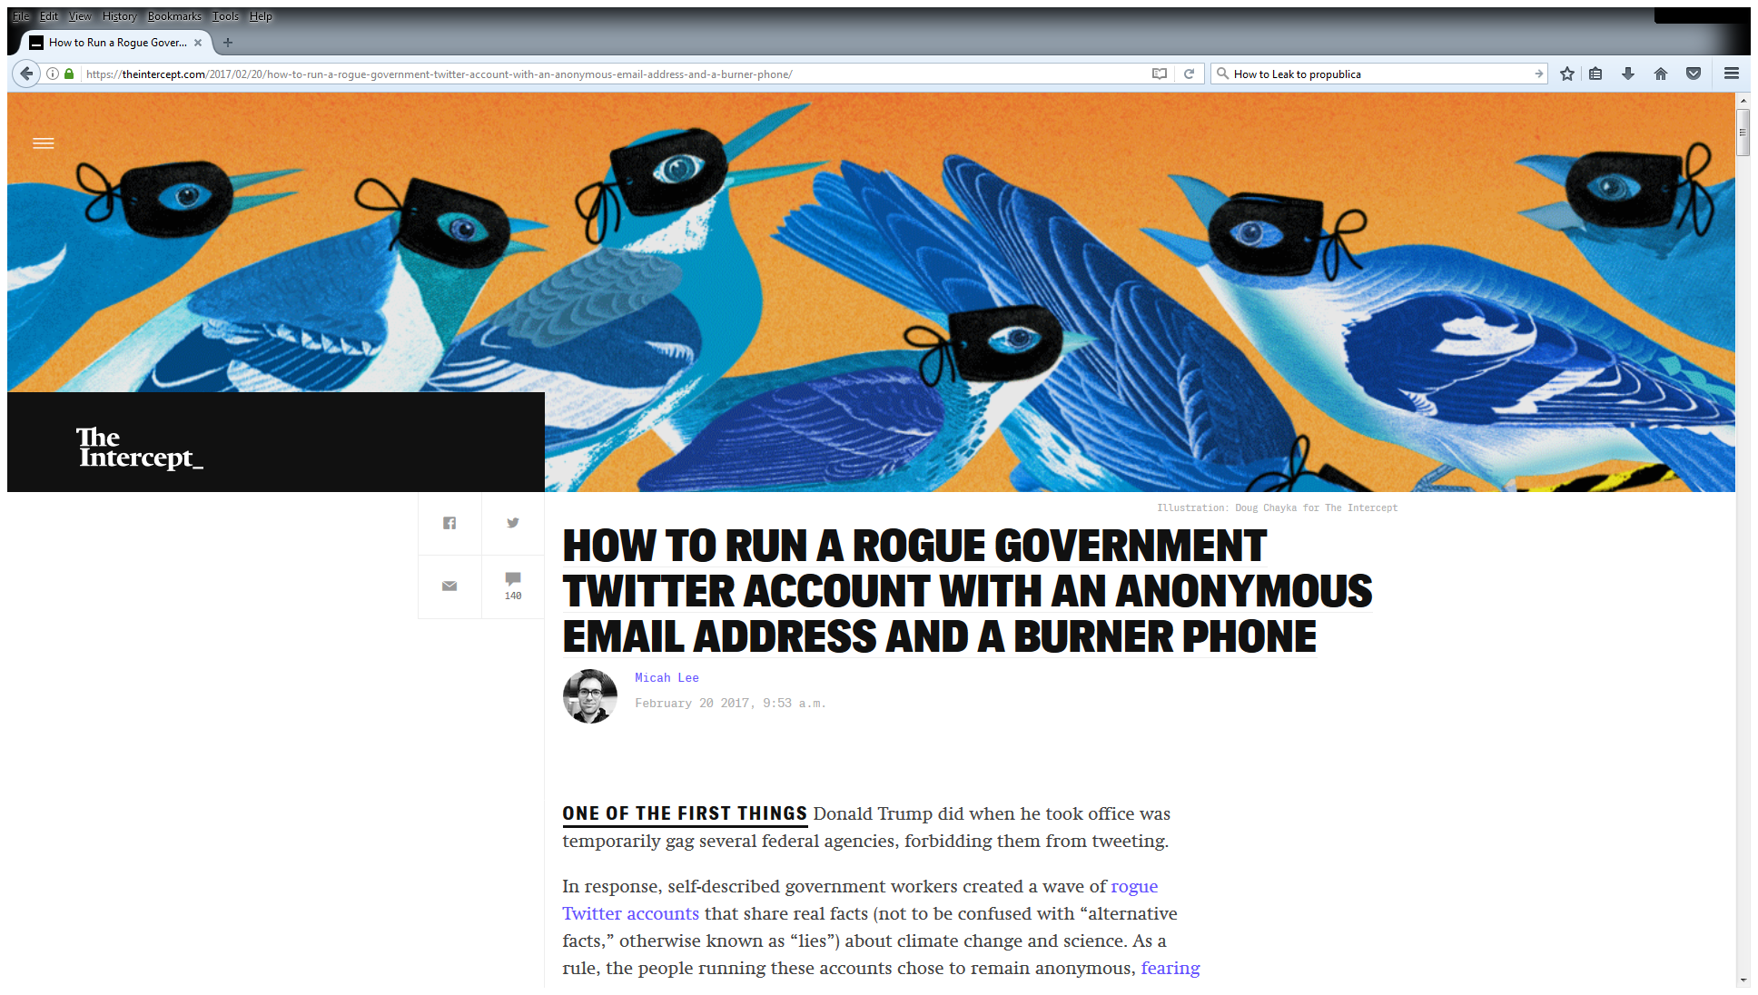

Slide 7
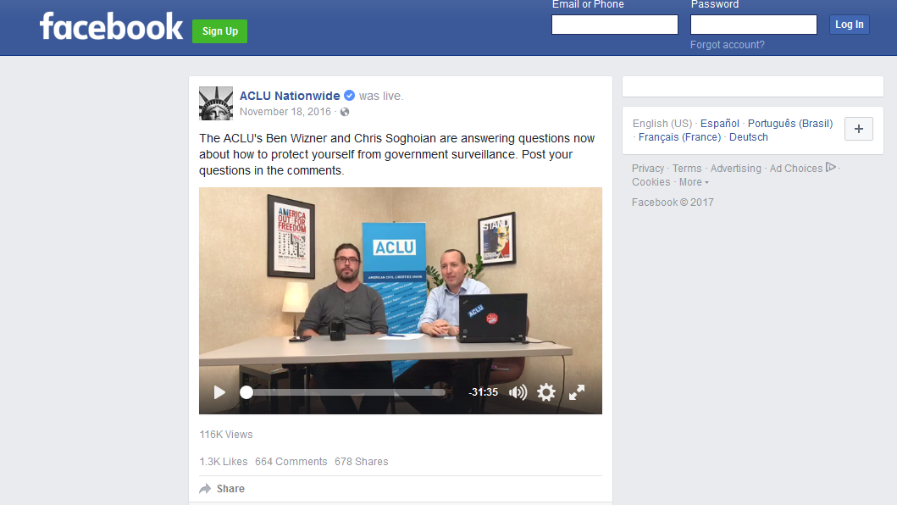
“How to Protect Yourself from
Government Surveillance”

Slide 8
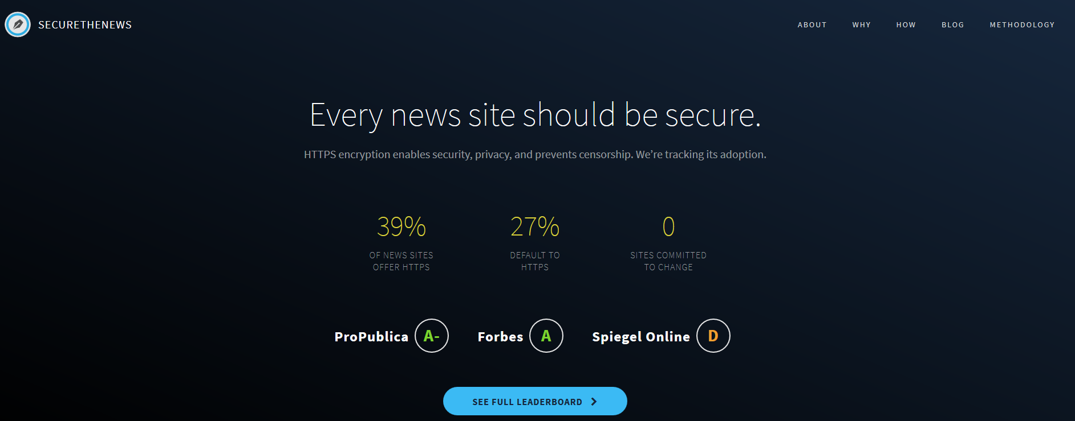

https://securethe.news/

Slide 9
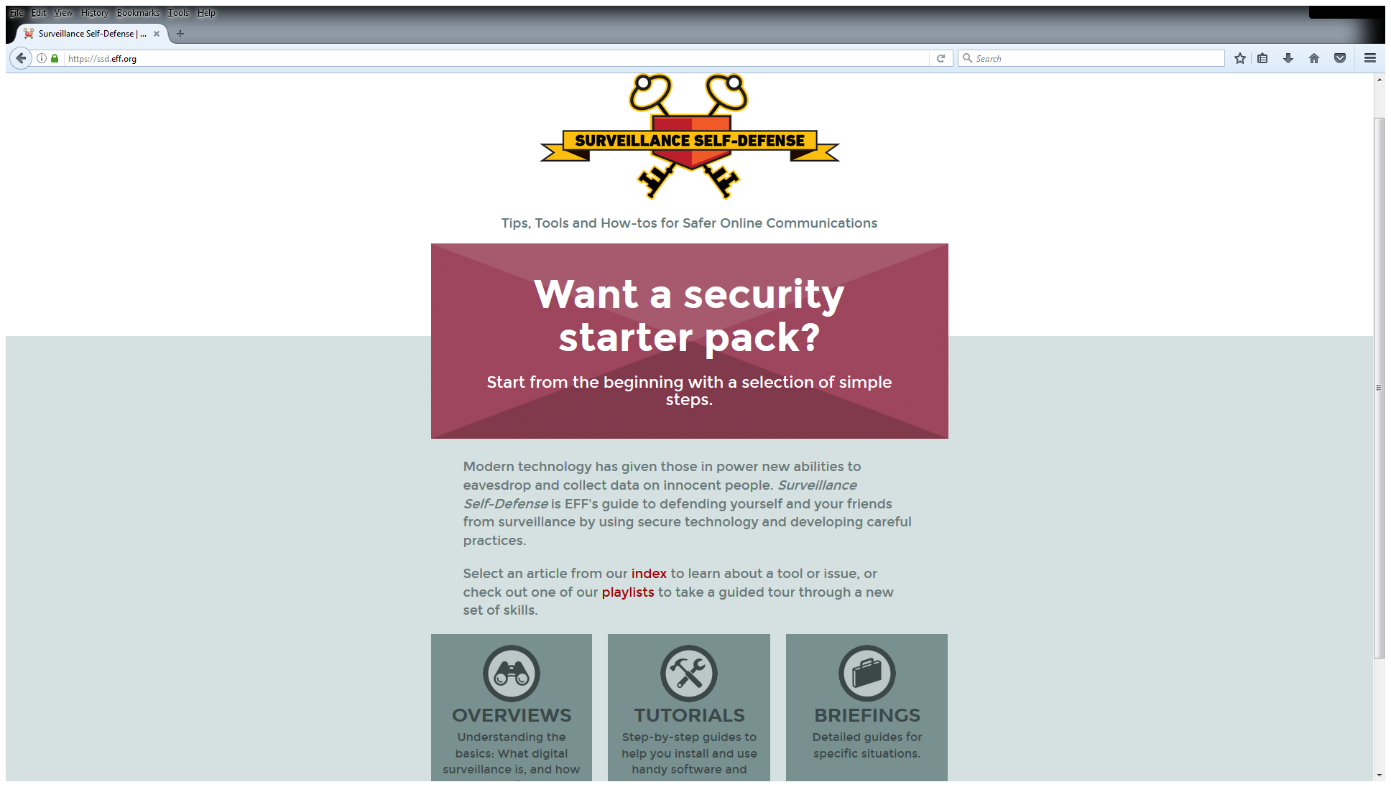

Slide 10
Resources
  http://security.engineering/talks/journalists2017/
Susan Sons’ – Cybersecurity Basics & Strategies
These slides

Slide 11
Protecting Sources in the Digital Age
Anthony Fargo, Ph.D.
Associate Professor, Media School
Director, Center for International Media Law
and Policy Studies

Slide 12
Shield Laws
Exist in 39 states and D.C.
All other states except Wyoming have appellate case law supporting journalists’ limited right to conceal sources
No federal shield law
Supreme Court has said the First Amendment does not create a right to conceal sources

Slide 13
Shield Laws
The problem: state shield laws do not protect journalists from subpoenas for phone records and other data
Proposed federal shield laws would have done so, but never passed
Federal appellate courts have said journalists do not have a right to challenge subpoenas to phone companies for call records

Slide 14
Illustration of the Problem
James Risen case
  Risen’s book revealed botched intelligence op.
  Alleged source (Jeffrey Sterling) was indicted based on phone and e-mail records
    For disclosing classified material
  Risen refused to testify against Sterling
  Sterling was convicted anyway

Slide 15
Lessons for Journalists
If source wants to provide sensitive data:
  Use a secure “drop box” online
  Use “burner” phones, encrypted e-mail, TOR or similar technology
  Or, go “old school” and only meet in secluded places (but watch for cameras!)

Slide 16
Cybersecurity for Journalists
(and Everyone!)
Moderator: Joe Tomain, Maurer School of Law
Nate Cardozo, Electronic Frontier Foundation
Anthony Fargo, Media School
Marisa Kwiatkowski, Indianapolis Star
Susan Sons, Center for Applied Cybersecurity Research
Sponsors
The Media School * Maurer School of Law
Center for Applied Cybersecurity Research
Center for International Media Law and Policy Studies

Slide 17
Cybersecurity for Journalists
(And Everyone!)
Susan Sons
Senior Systems Analyst
Center for Applied Cybersecurity Research
Indiana University

Slide 18
Cybersecurity for Journalists
(and Everyone!)
Moderator: Joe Tomain, Maurer School of Law
Nate Cardozo, Electronic Frontier Foundation
Anthony Fargo, Media School
Marisa Kwiatkowski, Indianapolis Star
Susan Sons, Center for Applied Cybersecurity Research
Sponsors
The Media School * Maurer School of Law
Center for Applied Cybersecurity Research
Center for International Media Law and Policy Studies

Slide 19
Cybersecurity for Journalists
(and Everyone!)
Nate Cardozo
Senior Staff Attorney
Electronic Frontier Foundation

Slide 20
Cybersecurity for Journalists
(and Everyone!)
Moderator: Joe Tomain, Maurer School of Law
Nate Cardozo, Electronic Frontier Foundation
Anthony Fargo, Media School
Marisa Kwiatkowski, Indianapolis Star
Susan Sons, Center for Applied Cybersecurity Research
Sponsors
The Media School * Maurer School of Law
Center for Applied Cybersecurity Research
Center for International Media Law and Policy Studies

Slide 21
Cybersecurity for Journalists
(and Everyone!)
Marisa Kwiatkowski
Investigative journalist
Indianapolis Star

Slide 22
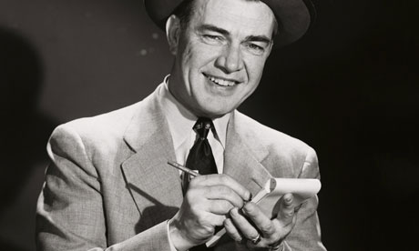
Practical tips for cybersecurity: A journalist’s perspective

Slide 23
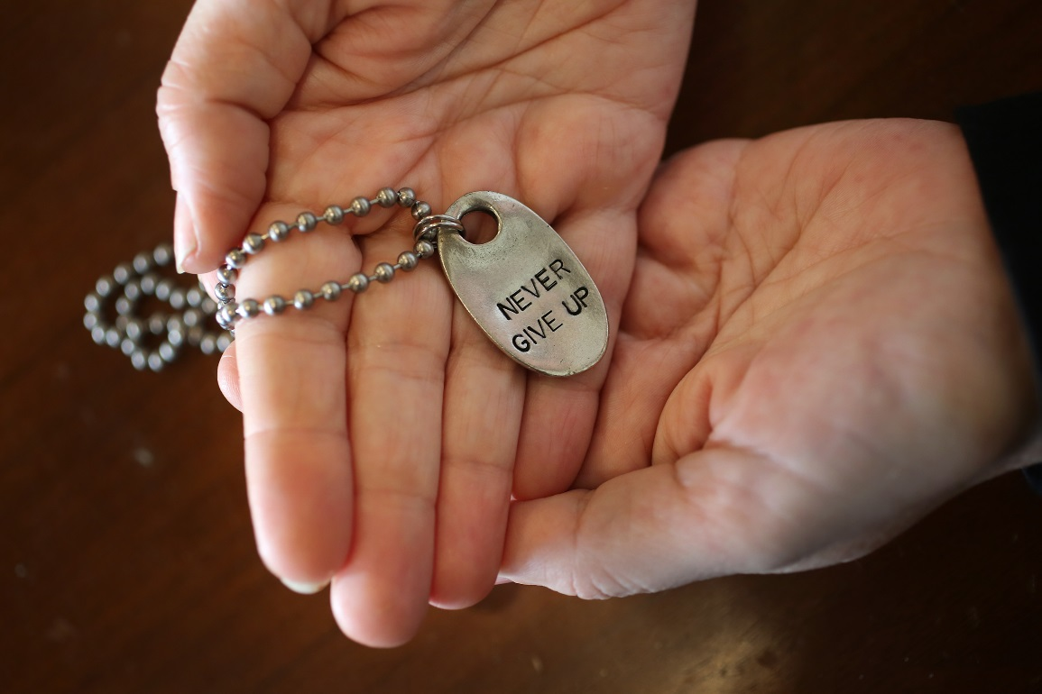
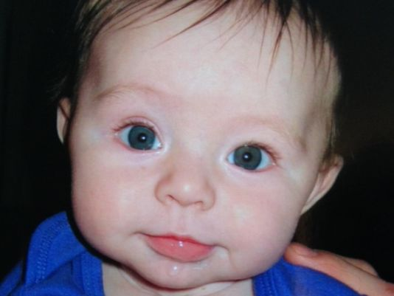
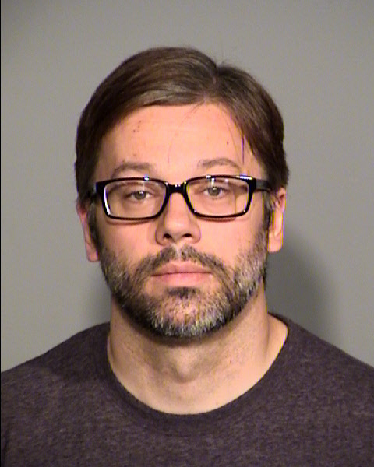
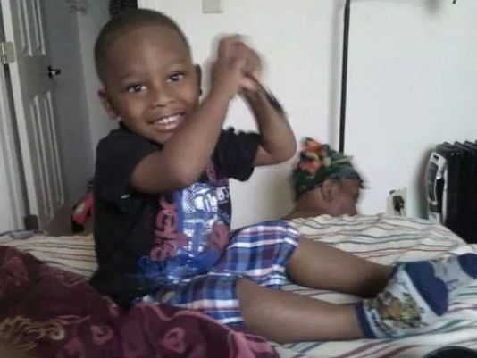
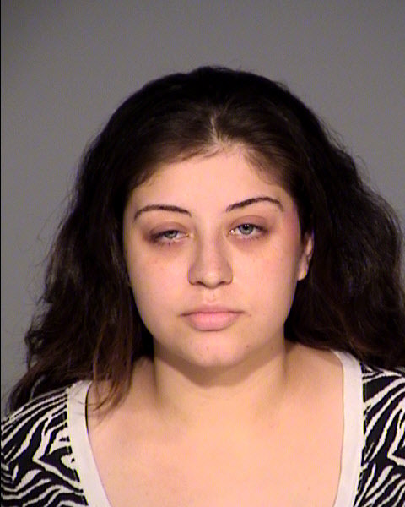
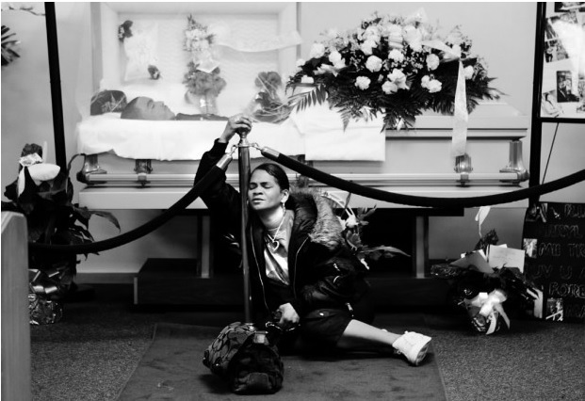

Slide 24
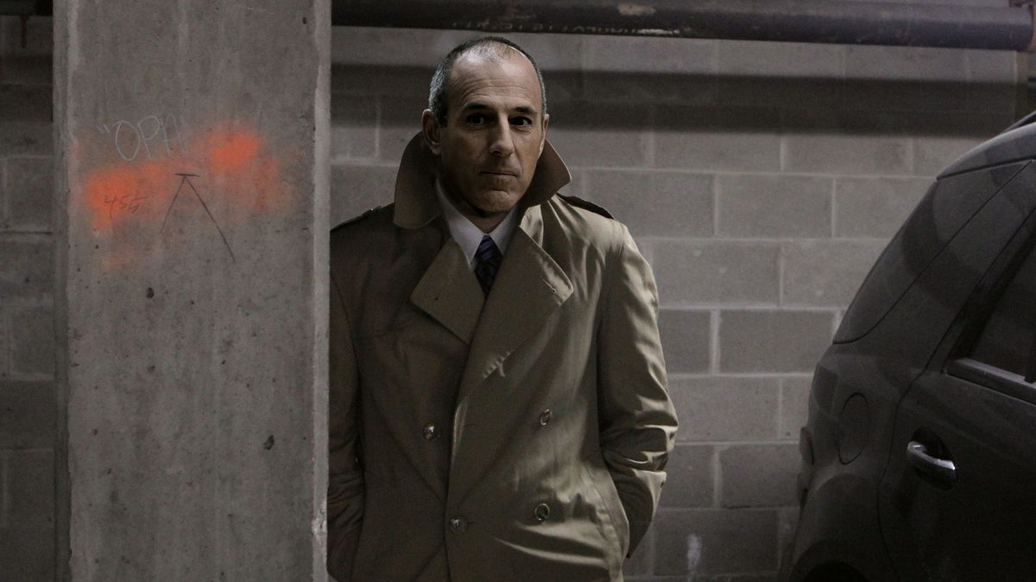

Slide 25


Signal
Browser Security

Slide 26

Rule No. 1
There’s nothing to hack if there’s nothing to find.

Slide 27
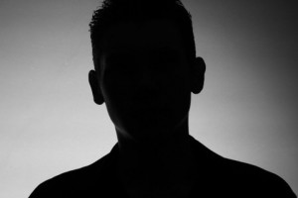
Rule No. 2
Give the public enough detail.

Slide 28
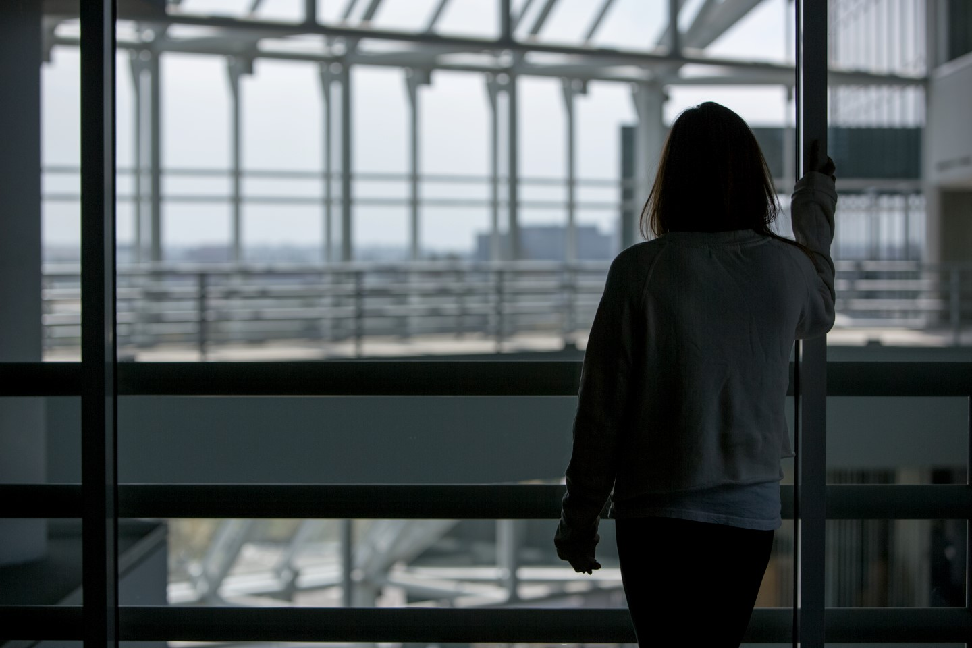

Slide 29


Slide 30

Rule No. 3
Don’t connect on social media — at least not right away.

Slide 31
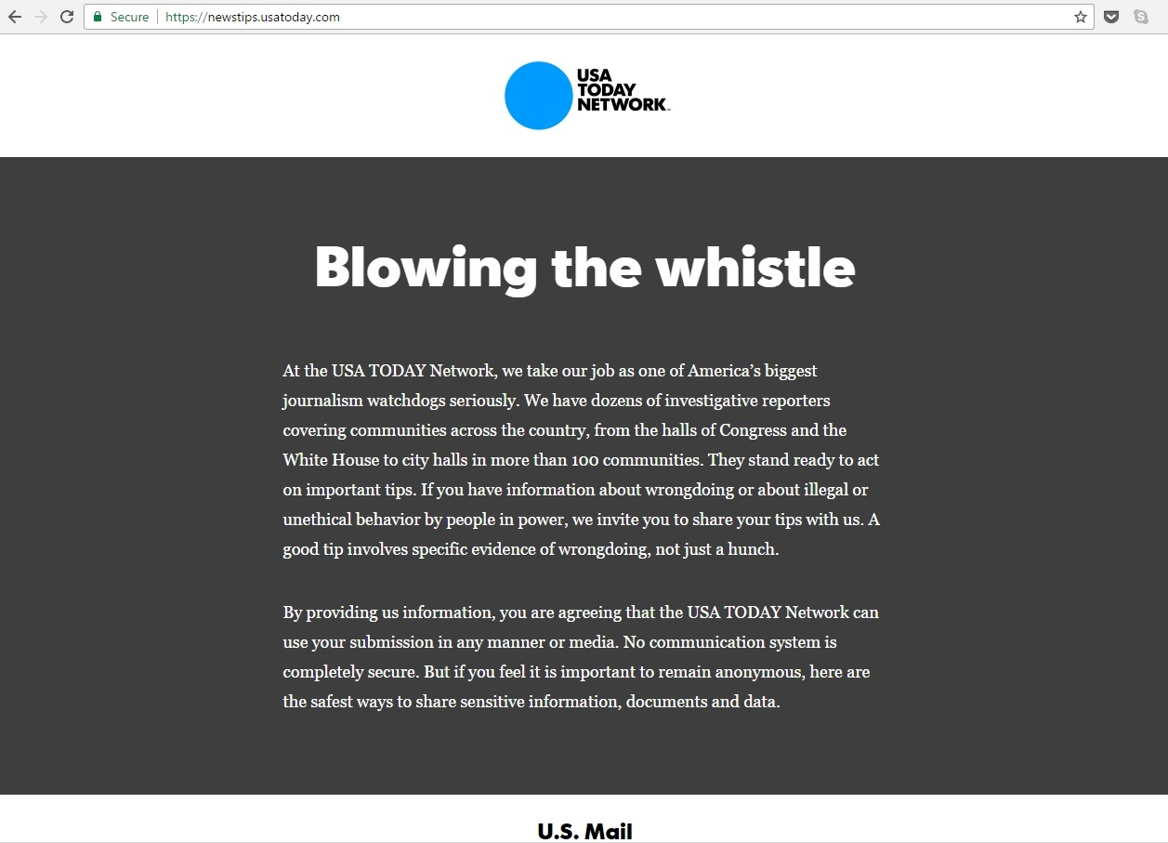

Slide 32
Cybersecurity for Journalists
(and Everyone!)
Moderator: Joe Tomain, Maurer School of Law
Nate Cardozo, Electronic Frontier Foundation
Anthony Fargo, Media School
Marisa Kwiatkowski, Indianapolis Star
Susan Sons, Center for Applied Cybersecurity Research
Sponsors
The Media School * Maurer School of Law
Center for Applied Cybersecurity Research
Center for International Media Law and Policy Studies

Slide 33
Resources
  http://security.engineering/talks/journalists2017/
Susan Sons’ – Cybersecurity Basics & Strategies
These slides

